Slide 1
LAND NAVIGATION
Navigate from One Point to Another During the Day and Night
EXPERT FIELD MEDICAL BADGE
HANDS-ON TASKS

Slide 2
Topics
Objective
Requirements
Misc Lane Information
Task, Conditions, and Standards
Map Reading and Land Nav Basics
Negotiating Land Nav Course
Tips for Success
Questions
Time to Practice
Notes:
Here are the highlights of this presentation.

Slide 3
References
AMEDDC&S Pam 350-10
FM 3-25.26
GTA 05-02-013

Slide 4
Objective
The objective of the land navigation courses it to measure the candidate’s ability to navigate from a start point, through intermediate points, to an end point during daylight and darkness.

Slide 5
Requirements
The candidate must successfully complete the performance measures for both day and night courses to receive a GO. The tasks are tested in a field environment with the required equipment.

Slide 6
Land Nav Misc.
The Land Nav Course will:
Be verified using a satellite type navigational system
Not use pre-established points and score sheets from previous EFMB tests.
Have a minimum of five start points and end points.

Slide 7
Land Nav Misc. Cont.
The host unit will:
Run standardization week the same as test week.
Ensure candidates, without assistance, are allowed only ONE OPPORTUNITY to complete the day and night courses during standardization week.
Place observers on the course to enforce land navigation standards
NOT review the points with the candidates upon completion of both the day and night courses during standardization and test weeks. Candidates will receive a GO or NO GO.

Slide 8
Land Nav Misc. Cont.
Candidates will:
Carry a red lens flashlight and a chemical light stick during the night course. The use of white light or chemical light stick is for EMERGENCIES ONLY.
Be briefed, prior to testing, on their responsibility to provide first aid to other candidates if the need arises. Candidates are NOT penalized for providing assistance. They will be allowed to retake the test without penalty if they should fail as a result of rendering aid.

Slide 9
Land Nav Misc. Cont.
Candidates will:
Be checked by host units for unauthorized test aids before and after the start of both the day and night courses.
Without assistance, must negotiate each course within the time specified in the respective standard. They will NOT be penalized for the time it takes to move from the end point to the score sheet collection point. Evaluators must be present at the end points to annotate the candidate’s end time.

Slide 10
Land Nav Misc. Cont.
The equipment required for the day and night courses is stated in the conditions statements for the tasks. NO OTHER EQUIPMENT IS AUTHORIZED. The host unit will issue the topographic map, score sheet, and the eight digit coordinates of the five points to the candidates for both the day and night courses. The map and score sheet must be returned to the host unit upon completion of each course.

Slide 11
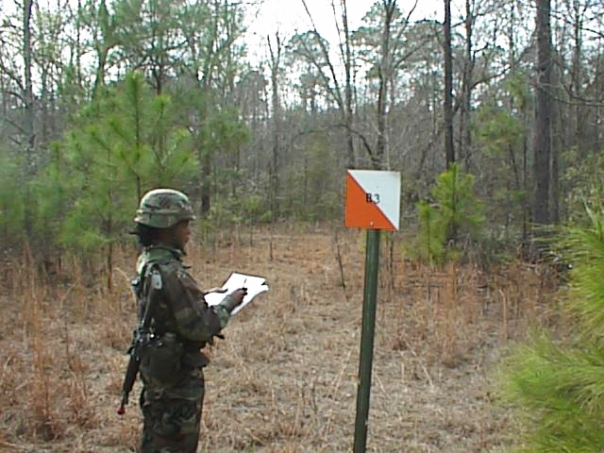
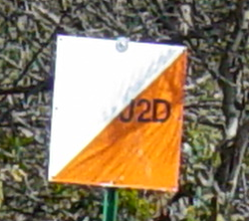
Land Nav Signs
Each point will be marked with a sign. The sign will:
Be constructed of metal or wood
Measure 12 inches by 12 inches
Be painted diagonally half-white and half-international orange
Be staked into the ground so that its bottom is between 5 and 7 feet above the ground. It will not be mounted on vegetation
Have a clearly identifiable, unique letter or number on it for identification. Other markings (grid coordinates, azimuths, directions) are not authorized.

Slide 12
Task
Navigate From One Point to Another During the Day

Slide 13
Conditions
Given a standard topographic map, scale 1:50,000; a lensatic compass; Graphic Training Aid (GTA) 05-02-012 (coordinate scale and protractor); a pencil; a score sheet; and the eight digit grid coordinates of the start point, three intermediate points, and end point.

Slide 14
Standards
Plot the start point, intermediate points, and the end point on the map. Navigate from the start point, through each intermediate point, in order, to the end point, within 3 hours.

Slide 15
Day Land Nav
The day course must measure between 3,500 and 4,000 meters. The course has three direction changes, the first at point one (not the start point). No point on the course, to include distractor points, will be closer than 100 meters to another point. Candidates must navigate the course IAW the task standards.

Slide 16
Performance Steps
1. Plot all five points on the map.
2. Navigate from the start point, through the intermediate points, to the end point.

Slide 17
Performance Measures
1. Navigated from the start point, through the intermediate points, in order, to the end point.
2. Correctly recorded the point number or letter of at least three points, excluding the start point.
3. Completed all performance measures within 3 hours.
4. Returned the map and score sheet.

Slide 18
Task
Navigate From One Point to Another During the Night

Slide 19
Conditions
Given a standard topographic map, scale 1:50,000; a lensatic compass; GTA 05-02-012 (coordinate scale and protractor); a pencil; a score sheet; a red-lens flashlight; a chemical light stick for emergency use; and the eight digit grid coordinates of the start point, three intermediate points, and end point.

Slide 20
Standards
Plot the start point, intermediate points, and the end point on the map. Navigate from the start point, through each intermediate point, in order, to the end point, within 4 hours.

Slide 21
Night Land Nav
The night course must measure between 3,000 and 3,500 meters. The course has three direction changes, the first at point one, not the start point). No point on the course, to include distractor points, will be closer than 100 meters to another point. Candidates must navigate the course IAW the task standards.

Slide 22
Night Land Nav Cont.
Artificial illumination (such as light sticks) may be used to mark the general boundaries of the course, but not the individual points. Candidates may NOT use artificial illumination or red-lens flashlight to MARK THEIR DIRECTION.
The host unit may start the night course no earlier than 1 hour after sunset. The test board chairperson will determine the actual start time based on local conditions.

Slide 23
Performance Steps
1. Plot all five points on the map.
2. Navigate from the start point, through the intermediate points, to the end point.

Slide 24
Performance Measures
1. Navigated from the start point, through the intermediate points, in order, to the end point.
2. Correctly recorded the point number or letter of at least three points, excluding the start point.
3. Did not mark the route of travel with the red-lens flashlight.
4. Completed all performance measures within 4 hours.
5. Returned the map and score sheet.

Slide 25
Map Reading Basics
Prior to hitting the Land Navigation Course, there are some things you need to know or should refresh on.
Map reading is no longer on the written test, but knowing the basics will assist you in effectively and efficiently negotiating the Land Navigation Courses.

Slide 26
What is a Map?
A map is a graphic representation of a portion of the earth’s surface drawn to scale, as seen from above.

Slide 27
Colors on a Map
Green: Vegetation
Brown: Relief and elevation
Black: Man-made features
Red: Major roads, populated areas
Blue: Water
Red-Brown: Cultural features, all relief features, and elevation, such as contour lines on red-light readable maps

Slide 28
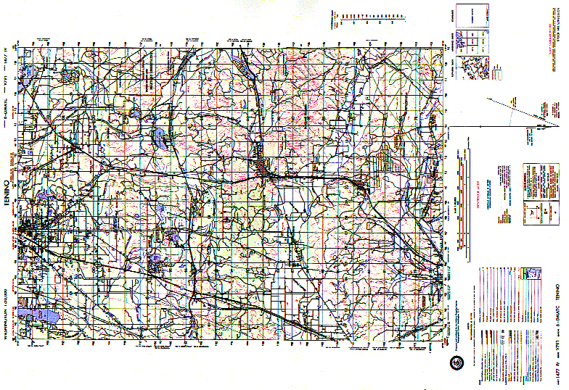
Topographic Map
7
27
8
2
9
26
5
24
25
6
10
11
12
1
4
21
13
14
15
16
17
18
20
4
1
6
3
23
5
19
22
2

Slide 29
Sheet Name
Sheet Number
Series Name
Scale
Series Number
Edition Number
Index to Boundaries
Adjoining Sheets Diagram
Elevation Guide
Declination Diagram
Bar Scales
Contour Interval Note
Spheroid Note
Grid Note
Projection Note
Vertical Datum Note
Horizontal Datum Note
Control Note
Preparation Note
Printing Note
Grid Reference Box
Unit Imprint and Symbol
Legend
7
27
8
2
9
26
5
24
25
6
10
11
12
1
4
21
13
14
15
16
17
18
20
4
1
6
3
23
5
19
22
2

Slide 30
Parts of a Map
Name, series name, series number, etc.
Scale
Legend
Contour interval
Bar scale
Declination diagram
Grid reference box
Additional information

Slide 31
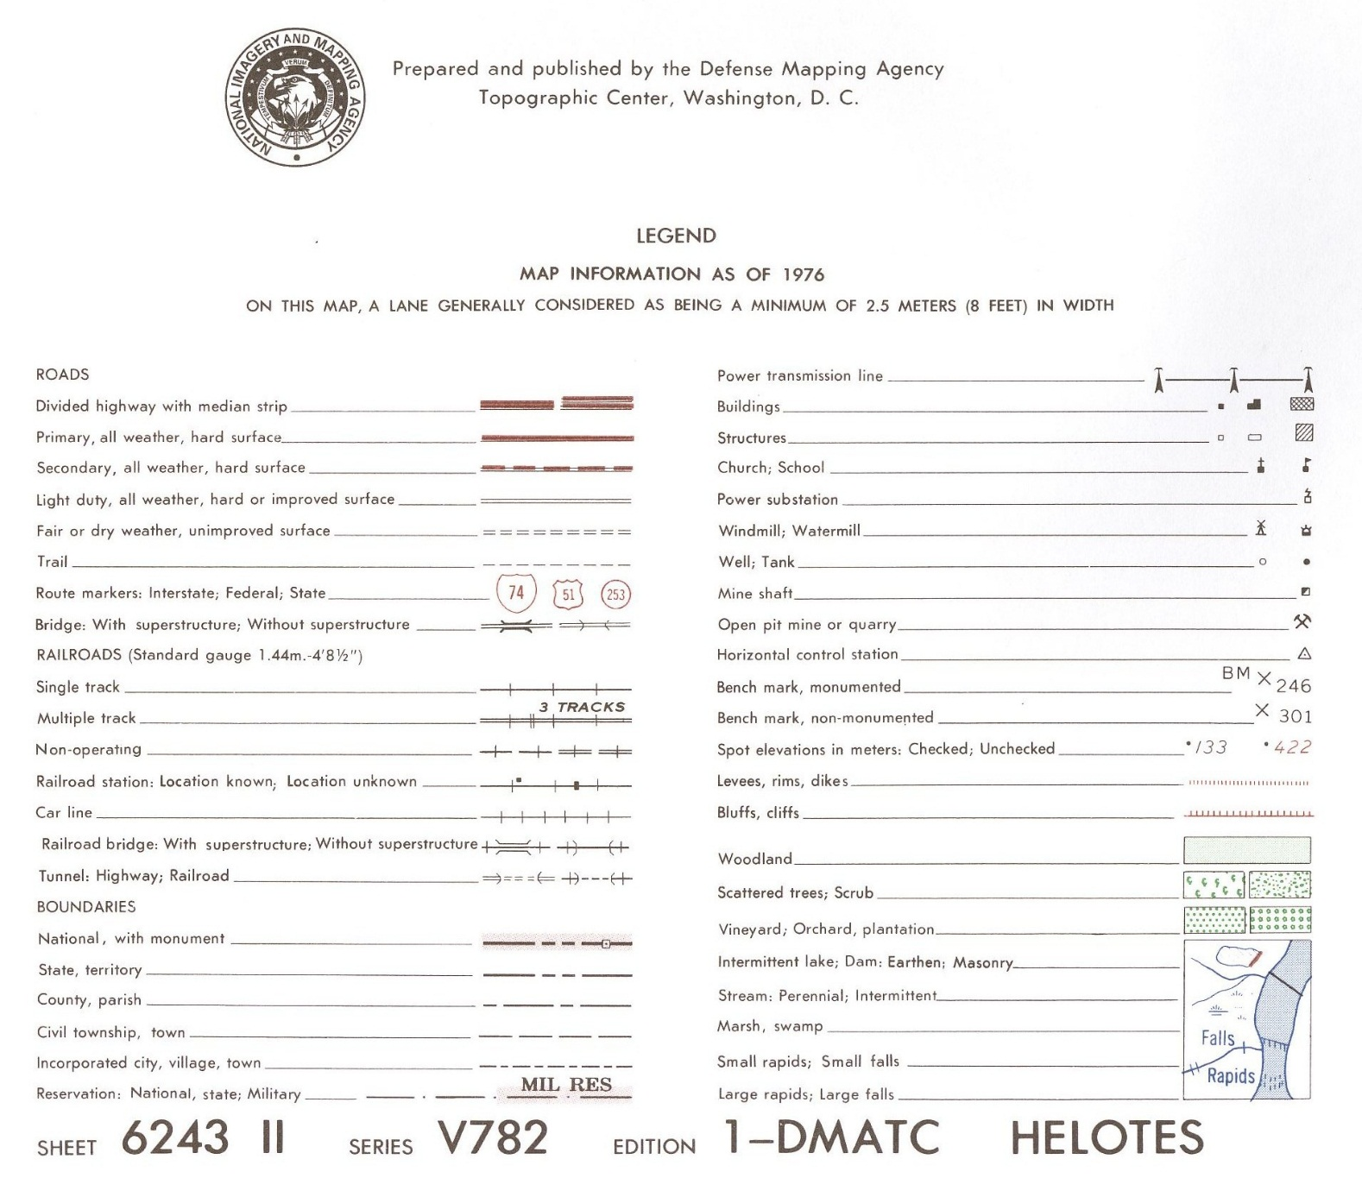
Legend

Slide 32
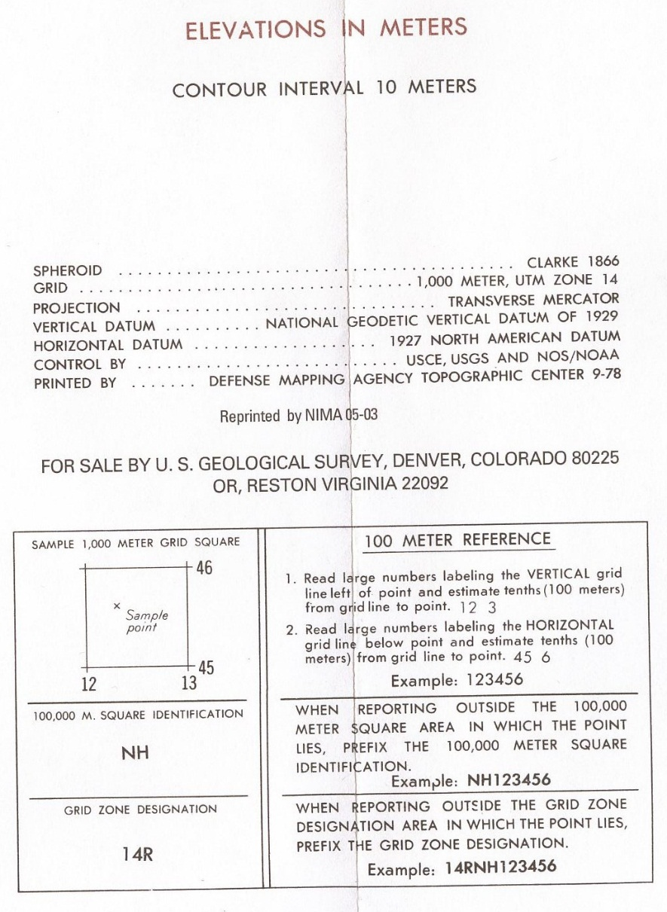
Contour Interval
Grid Reference Box
This is where you find the contour interval
This is where you find
Your Grid Zone Designators (the 2 letters)

Slide 33
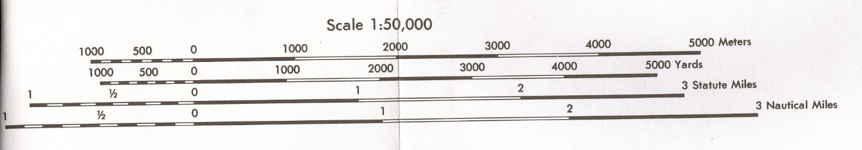
Bar Scale
Located in lower margin of map
Can measure map distance in:
  Statute miles
  Meters
  Yards
  Nautical miles
Each is broken into two scales
  Primary (Right side)
  Extension (Left side)

Slide 34
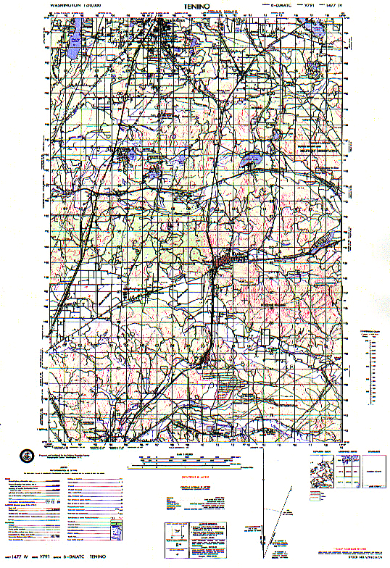

Scale of Map
Scale: 1:50,000. This means that one unit of measurement on the map is equal to fifty thousand of the same unit on the ground.
1 Inch on the map is 50,000 inches on the ground, 1 pencil on the map is 50,000 pencils on the ground etc.
Use 1:50,000 on
protractor

Slide 36
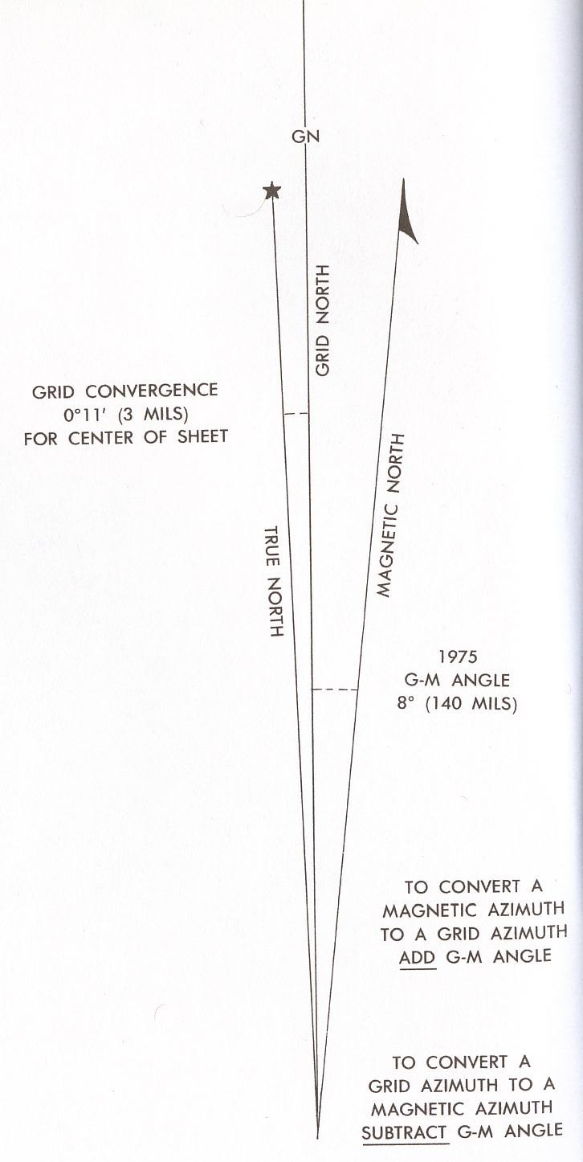
Declination Diagram
Declination Diagram
  Three Types of North
    Grid
      Y or GN
    Magnetic
      Arrow
    True
      Star
  GM Angle
    Normally stated how to figure out
    Different dependent on which hemisphere you are

Slide 37
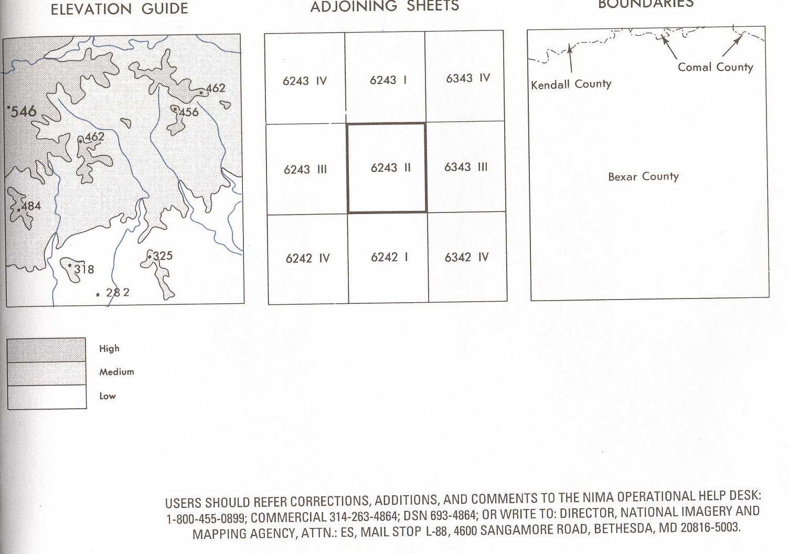
Additional Information

Slide 38
Terrain Features
Major Terrain Features
  Hill
  Saddle
  Valley
  Ridge
  Depression
Supplementary Terrain Features
  Cut
  Fill
Minor Terrain Features
  Draw
  Spur
  Cliff

Slide 39
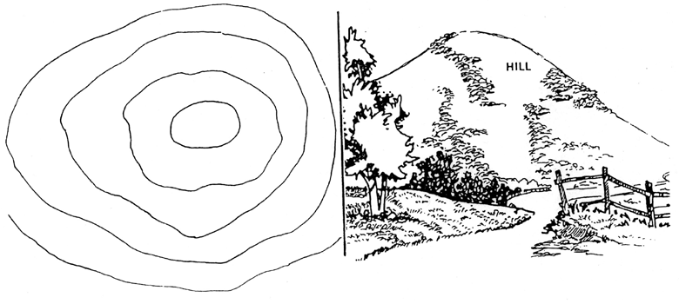
Hill

Slide 40
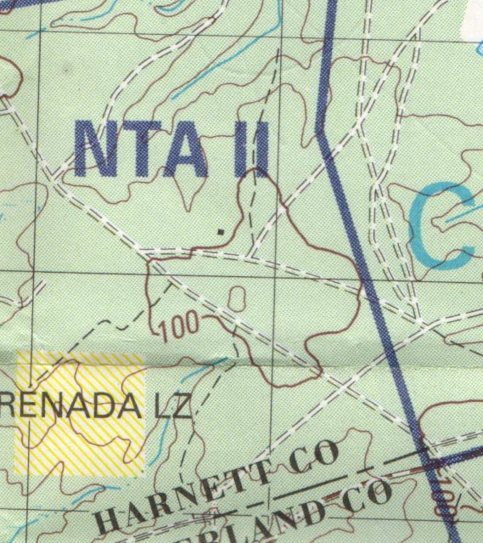
Hill

Slide 41
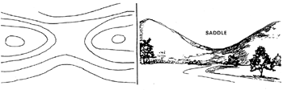
Saddle

Slide 42
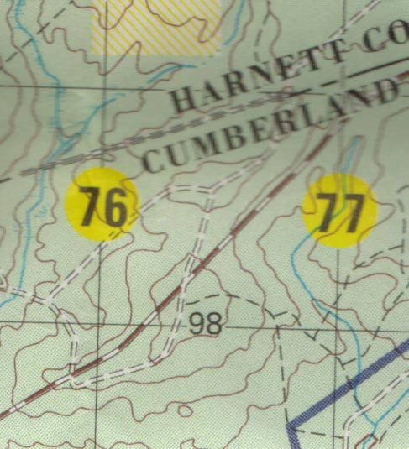
Saddle
Notice the
high
ground
on
both sides

Slide 43
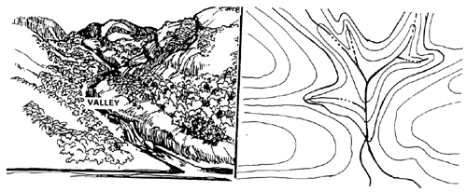
Valley

Slide 44
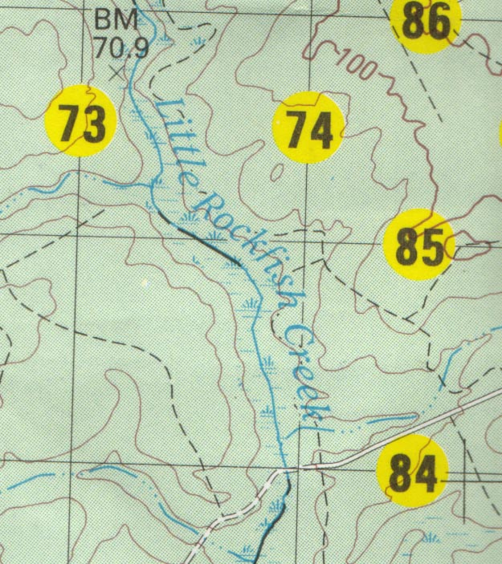
Valley

Slide 45
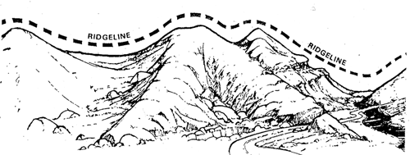
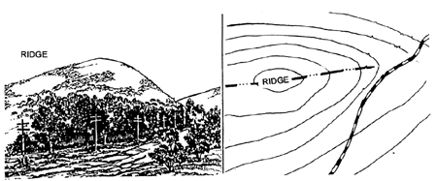
Ridge

Slide 46
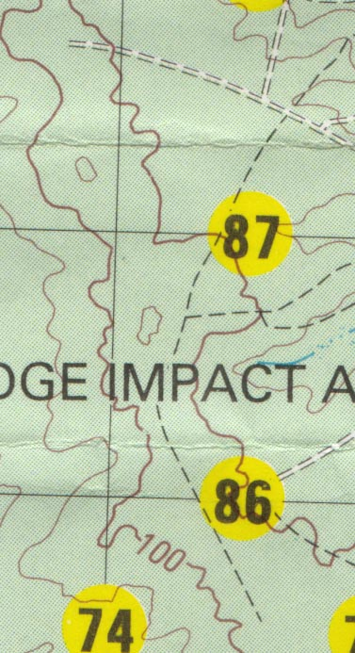
Ridge

Slide 47
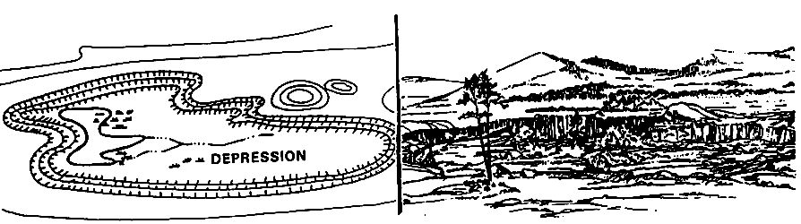
Depression

Slide 48
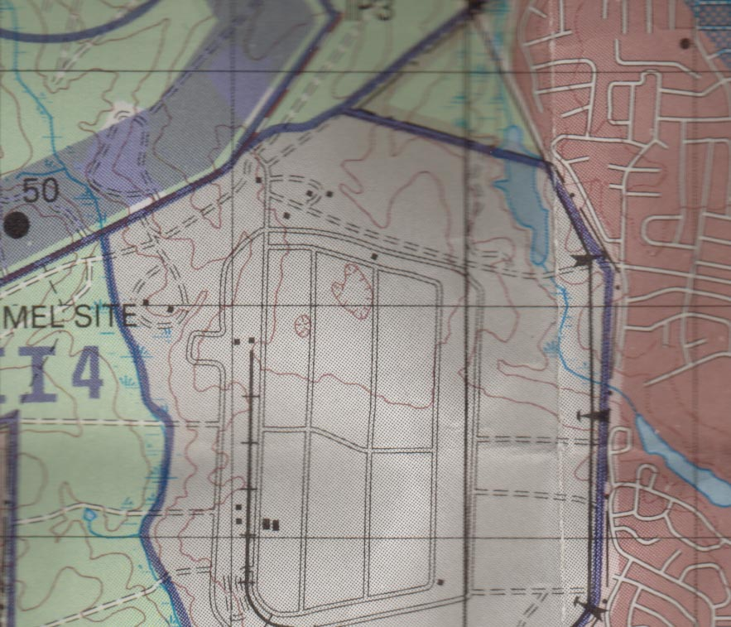
Depression

Slide 49
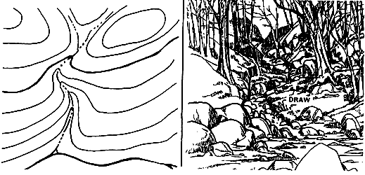
Draw

Slide 50
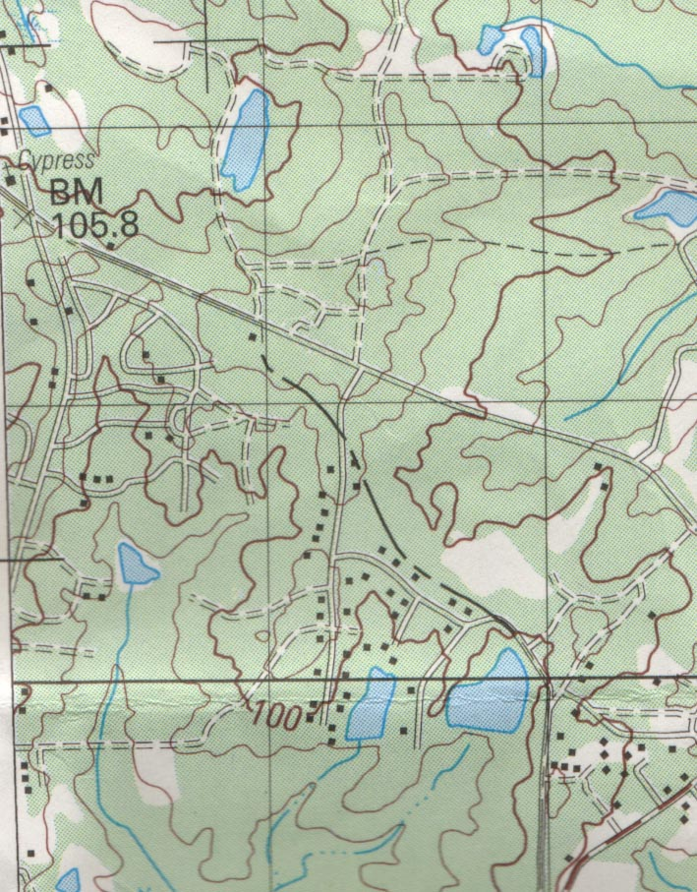
Draw
Note: the V of the contour lines points up hill

Slide 51
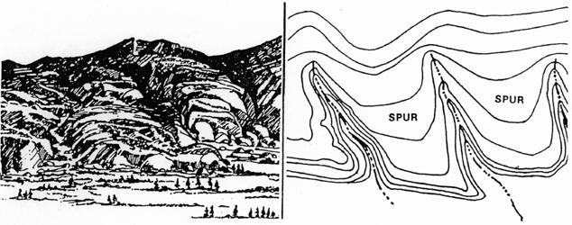
Spur

Slide 52
Spur
Note: the V of the contour lines points down hill

Slide 53
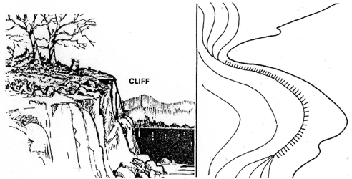
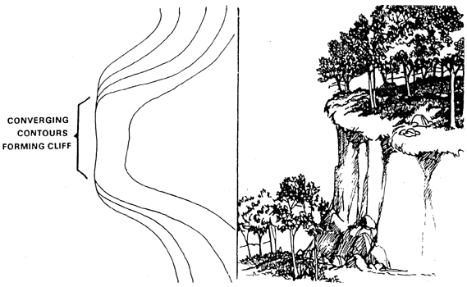
Cliff

Slide 54
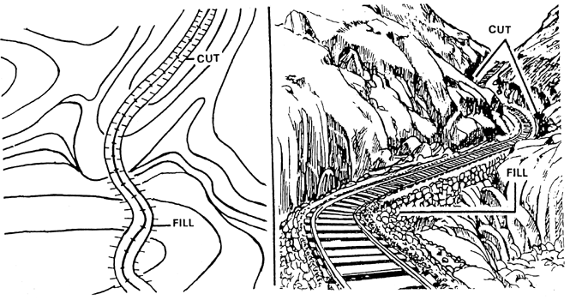
Cut and Fill

Slide 55
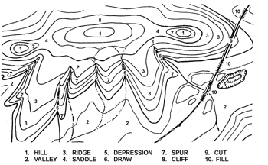
Terrain Features
Hill
Valley
Ridge
Saddle
Depression
Draw
Spur
Cliff
Cut
Fill

Slide 56
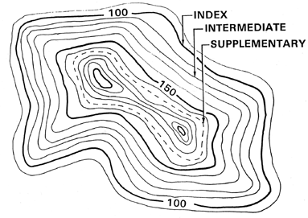
Contour Lines
Index
  Thick dark contour line
  Every 5th contour line
  Shows elevation
Intermediate
  Lay between the Index contour lines
  Thin contour lines
Supplementary
  Dashed
  Show changes of elevation at least ½ contour interval

Slide 57
Determining
Relief and Elevation
First, find the contour interval
Contour lines
  Find the elevation of the closest contour line (visible)
  Add the contour interval for each contour line
Hilltop
  Find the elevation of the closest contour line
  Add ½ the contour interval
Depression
  Find the elevation of the closest contour line below the depression
  Subtract ½ the contour interval

Slide 58
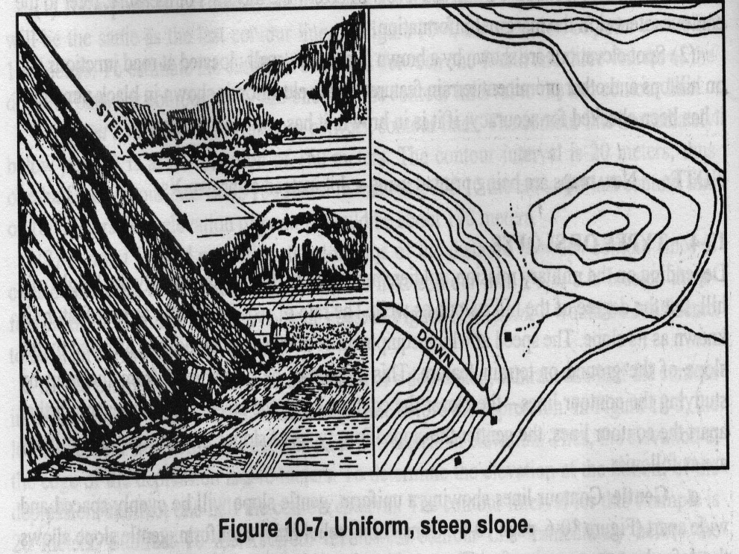
Determining
Relief and Elevation
  The closer the contour lines, the steeper the slope
  The farther they are apart, the more gradual the slope

Slide 59
Relief and Elevation PE
Determine the elevation at each of the following:
Contour Interval:
10 meters
205 m
140 m
150 m

Slide 60
Check on Learning
Utilizing the map in front of you,
answer the following questions:
What is the scale of this map?
What is the contour interval?
What is the GM angle?
What is the different types of north?
Where are the different types of contour lines?

Slide 61
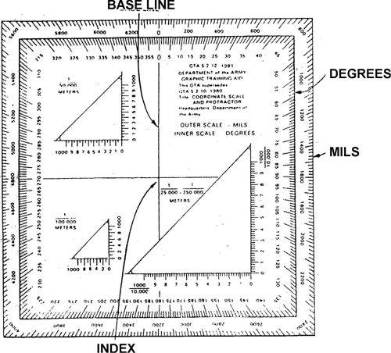
Protractor
Coordinate Scale and Protractor
  GTA 5-2-12
Measuring azimuths
  Outer Edge = Mils (6400 in a circle)
  Inside = Degrees (360 in a circle)
3 scales
  1:50,000
  1:100,000
  1:25,000
Cross hairs
  Used for plotting an azimuth

Slide 62
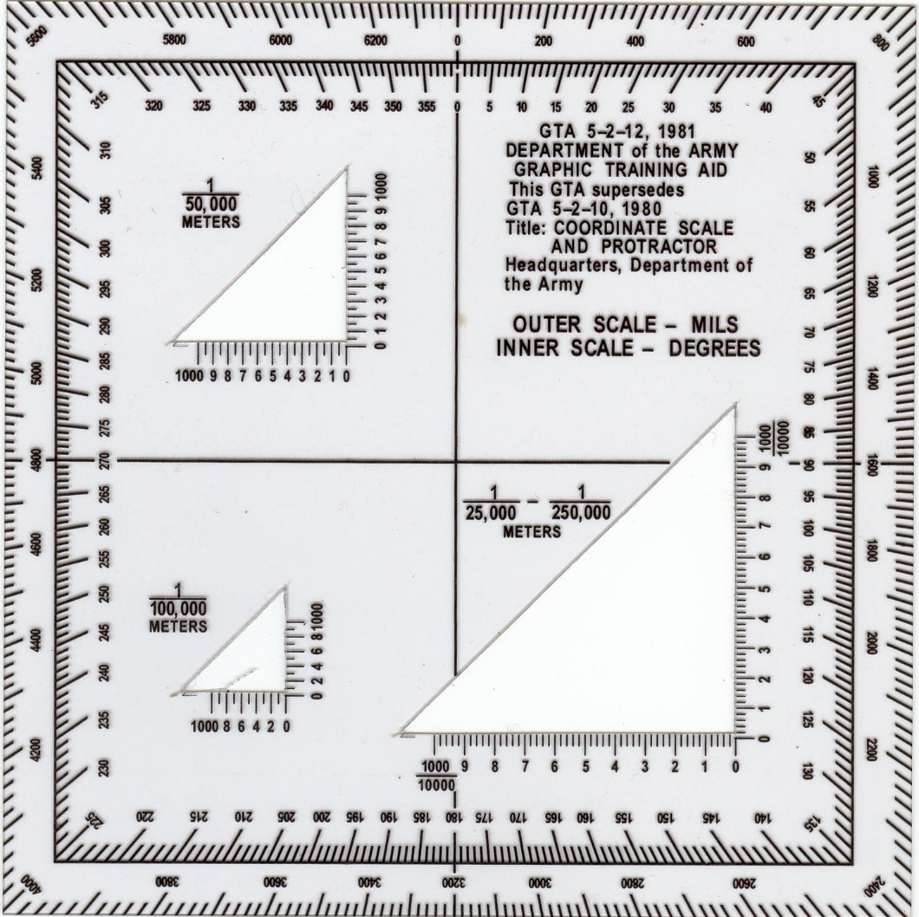
Protractor
Use this portion when
plotting points on a
1:50,000 scale map

Slide 63
Grid Coordinates
Grid Zone Designators
  Two letter prefix prior to grid coordinate
  Found in the grid reference box
4 digit grid coordinate
  Within 1,000 meters of your point
6 digit grid coordinate
  Within 100 meters of your point
8 digit grid coordinate
  Within 10 meters of your point

Slide 64
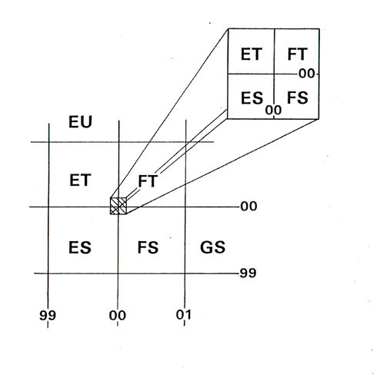
1000 Meter Grid Square

Slide 65
1000-Meter Reading
18
1000
Meters
17
16
15
01
02
03
04
05

Slide 66
Golden Rule of
Map Reading
Always read RIGHT and UP
UP
RIGHT

Slide 67
Finding a 4 Digit
10
Meters
100
Meters
16
03

Slide 68
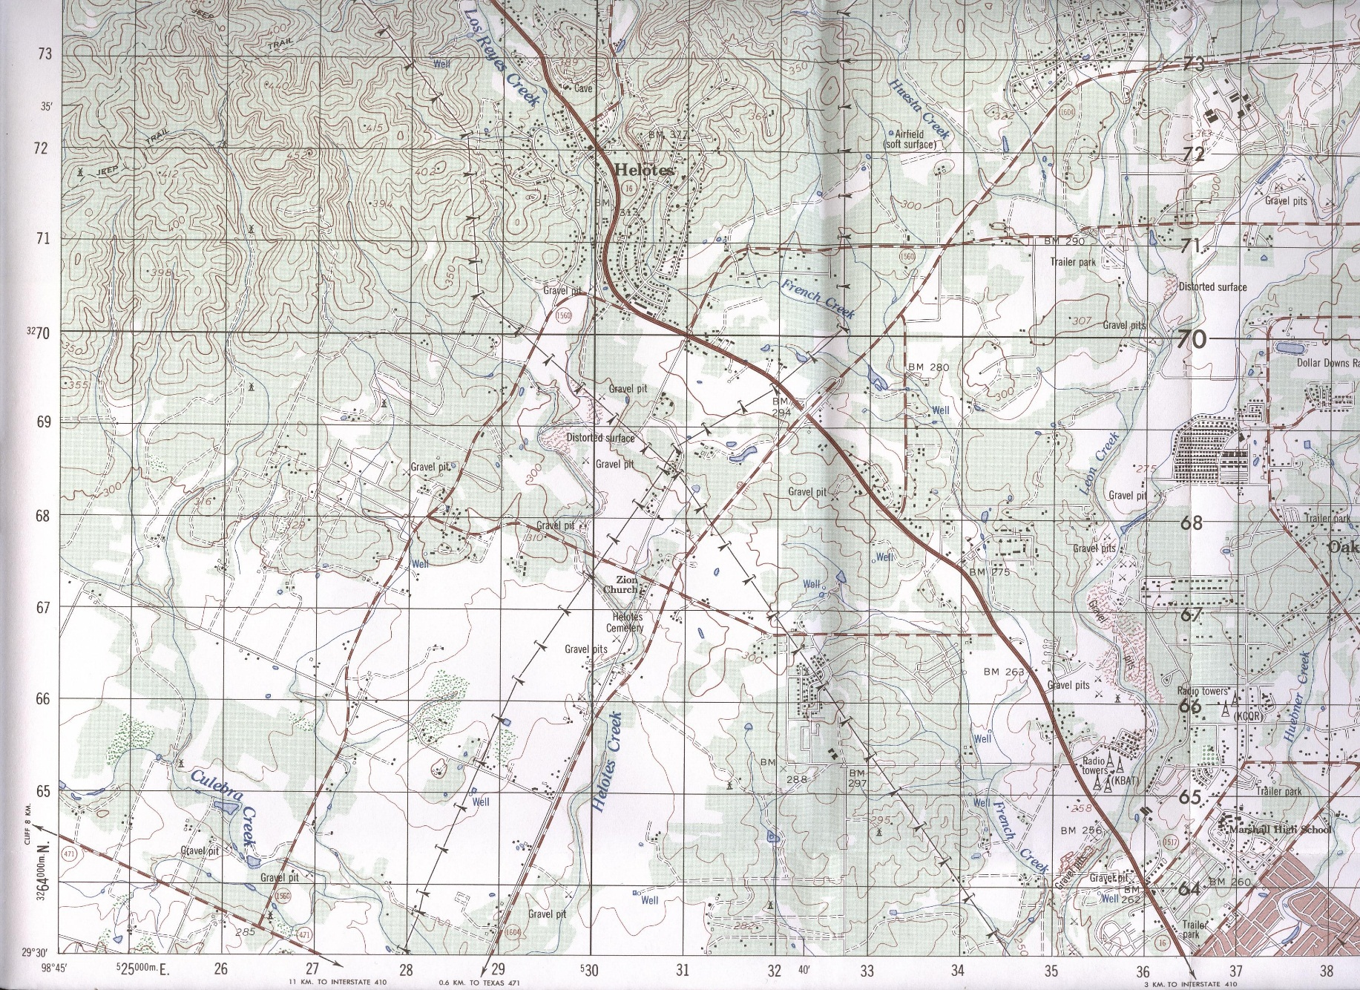
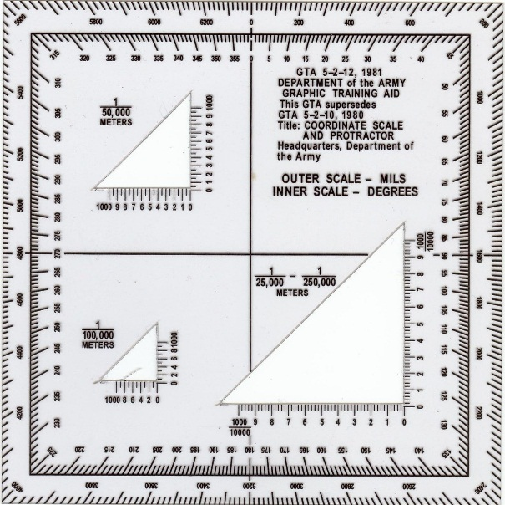
Finding a 4 Digit
Plot your point
Make a +
Point in upper right portion of +
Go RIGHT, and UP
2 7
6 8
NH__ __ / __ __

Slide 69
Plotting a 4 Digit PE
Give the 4 digit grid coordinate for each of the following:
1. Coordinates_________ Object: BM 253 north of Castle Hills
2. Coordinates_________ Object: Saint Andrew Church, SA
3. Coordinates_________ Object: Convent in Grey Forest (left side)
NH 4670
NH 4365
NH 3076

Slide 70
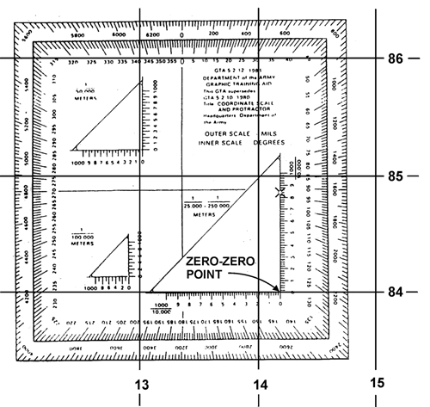
Finding a 6 Digit

Slide 71
Finding a 6 Digit
Plot your point
Make a +
Point in upper right portion of +
Go RIGHT, and UP
2 7
6 8
NH__ __ __/ __ __ __

Slide 72
Finding a 6 Digit
Place 1:50000 portion of protractor on left vertical line of grid square of point

Slide 73
Finding a 6 Digit
Slide protractor to the right till the upper vertical portion of 1:50000 bisects point
To get your 3rd number, use the horizontal numbers where they bisect the left grid line and round up or down.
To get your 6th number, read up the vertical numbers where the point bisects the line and round up or down.
Go RIGHT, and UP
2 7
6
6 8
8
NH__ __ __ / __ __ __

Slide 74
Plotting a 6 Digit PE
Give the 6 digit grid coordinate for each of the following:
1. Coordinates_________ Object: BM 253 north of Castle Hills
2. Coordinates_________ Object: Saint Andrew Church, SA
3. Coordinates_________ Object: Convent in Grey Forest (left side)
NH 465703
NH 437652
NH 303762

Slide 75
Finding an 8 Digit

Slide 76
Finding a 8 Digit
You now take it one step farther from the 6 Digit
Break each segment on the protractor (i.e. 0-1) into tenths.
To get your 3rd and 4th numbers, use the horizontal numbers where they bisect the left grid line.
To get your 7th and 8th numbers, read up the vertical numbers where the point bisects the line.
Go RIGHT, and UP
2 7
5 9
6 8
7 8
NH__ __ __ __ / __ __ __ __

Slide 77
Plotting an 8 Digit PE
Give the 8 digit grid coordinate for each of the following:
1. Coordinates_________ Object: BM 253 north of Castle Hills
2. Coordinates_________ Object: Saint Andrew Church, SA
3. Coordinates_________ Object: Convent in Grey Forest (left side)
NH 46467034
NH 43656520
NH 30277624

Slide 78
Check on Learning
Utilizing the map in front of you,
answer the following questions:
Where do you find the grid zone designators?
How close will a 6 digit grid coordinate put you to your point?
How close will an 8 digit grid coordinate put you to your point?
What is the golden rule of map reading?
Who is your favorite EFMB Train-Up Instructor?

Slide 79
Determining Distance
Straight Line Method
Used to measure the straight line distance between two points
Take a piece of paper and line it up through your start and end points
Put a small tick mark on the paper at each point
Move the paper to the bar scale and determine the distance in meters between the two tick marks

Slide 80
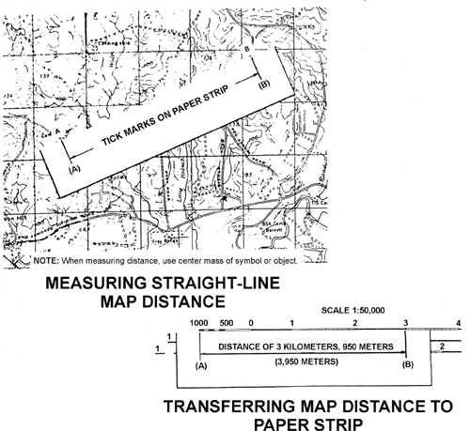
Straight Line Distance

Slide 81
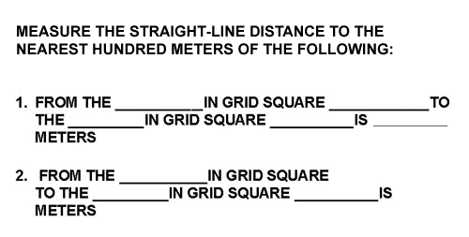
Straight Line Distance
Check on Learning
BM 253
NH 4670
BM 269
NH 4269
4250
BM 301
NH 4072
BM 253
NH 4269
6400

Slide 82
Determining Distance
On a Map
Curved or Road Method
Used to measure distance between two points, normally on a road
Utilizing a Piece of Paper
Place a piece of paper next to your start point and put a small tick mark
Align the paper with the roads edge until you come to a curve and make another tick mark on the map and paper
Pivot the paper along the road’s edge and repeat Step 2 until you reach the end point and mark it again
Move the paper to the bar scale and determine the distance
Note: Always stay on the same side of the road!!!!

Slide 83
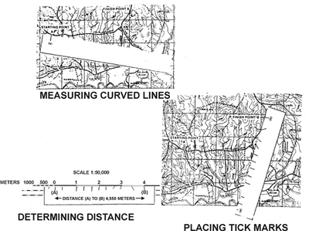
Measuring a
Curved Line Distance

Slide 84
Determining Distance
On a Map
Curved or Road Method
Used to measure distance between two points, normally on a road
Utilizing a Piece of Dental Floss or String
Place a piece of floss next to your start point and put a small tick mark on the floss
Align the floss with the roads edge until you come to a curve and then bend the floss along with the curvature of the road
Pivot the floss along the road’s edge until you reach the end point and put a tick mark on the floss
Straighten the floss out and move the floss to the bar scale and determine the distance
Note: Always stay on the same side of the road!!!!

Slide 85
Curved Line Distance
Check on Learning
Measure the road distance in the following:
1. From the road junction in grid square_______
to the intersection in grid square______is_____
kilometers.
2. From the intersection in grid square_______
to the intersection in grid square______is_____
meters.
NH 4282
NH 4083
2150
NH 4775
NH 4274
5500

Slide 86
Obtaining a Grid Azimuth
Plot your start and other points on the map
Center the cross hairs of your protractor on the start point
  Ensure that the protractor is parallel with the map
  Use the lines on the protractor with the grid lines on the map
Take a piece of paper or a ruler and run it from the start point (cross hairs) through your end point
  You can make a penciled in line on your map
Look on the inner circle (degrees), where the line crosses it. That is your grid azimuth

Slide 87

Obtaining a Grid Azimuth
Plot your Start Point and End Point.
EP
SP

Slide 88
Obtaining a Grid Azimuth
Place cross hairs of protractor over Start Point.
EP
SP

Slide 89
Obtaining a Grid Azimuth
Draw a straight line from SP to EP.
EP
Where the line bisects the degrees is your grid azimuth.
SP
36 degrees

Slide 90
Changing Grid Azimuth to Magnetic Azimuth
For land navigation, you must change your grid azimuths (from map) to magnetic azimuths (for your compass)
Look at your GM Angle on the map
Take your grid azimuths and Add or Subtract the GM Angle from it
  Dependent on your location on earth
  Your map will tell you what to do
This will give you your magnetic azimuths to navigate the land navigation course

Slide 91
GM Angle
The GM Angle for the map to the right is 8 degrees
The GM Angle for the map you have is ___ degrees
Magnetic=Major Grid= General
To convert magnetic to grid azimuth (In U.S.)
  Add GM Angle
    Going Major to General is a adding rank
To convert grid to magnetic azimuth (In U.S.)
  Subtract GM Angle
    Going General to Major is losing rank
    Note: It is the opposite if you are on the other side of the earth (i.e. Germany)

Slide 92
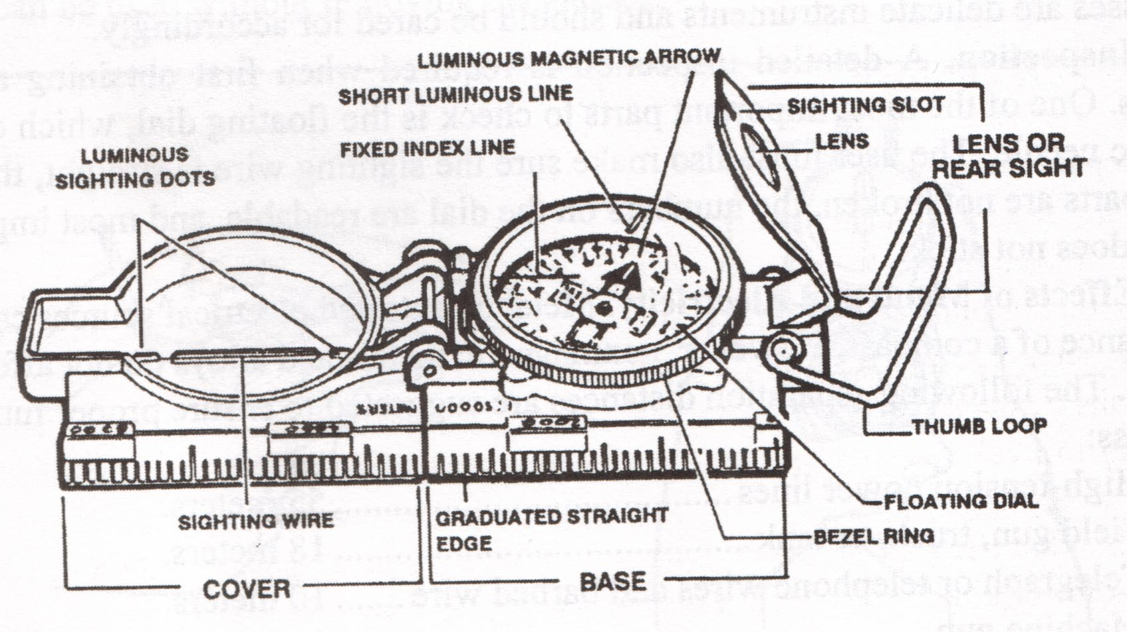
Compass
Notes:
(1) The floating dial is used to determine the direction in which you are pointing your compass. The outer “black” ring of numbers and tickmarks is used finding directions in mils while the “red” inner ring is used for direction in degrees.
(2) There are 360 degrees or 6400 mils in a circle. These are marked on the floating disk by a tick mark every 5 degrees or 20 mils. However, not every tick mark is numbered. You will have to determine the number for these lines using the numbers that are shown.

Slide 93
Using a Compass
Compass to Check Method
Centerhold Method
Notes:
(1) The floating dial is used to determine the direction in which you are pointing your compass. The outer “black” ring of numbers and tickmarks is used finding directions in mils while the “red” inner ring is used for direction in degrees.
(2) There are 360 degrees or 6400 mils in a circle. These are marked on the floating disk by a tick mark every 5 degrees or 20 mils. However, not every tick mark is numbered. You will have to determine the number for these lines using the numbers that are shown.

Slide 94
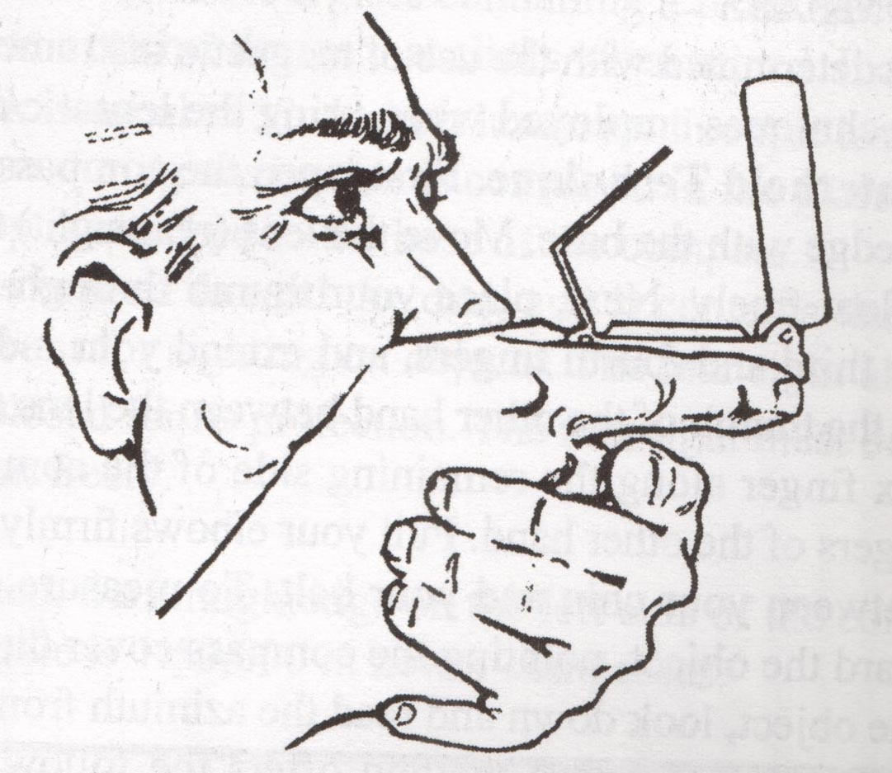
Compass to Cheek Method
Notes:
Compass-to-Cheek technique for holding a compass. When an azimuth has to be accurate you must use the compass-to-cheek method. To do this, open the cover to a 90-degree angle to the base. Position the eyepiece at a 45 degree angle to the base. Once you have the compass open, place your thumb through the thumb loop, form a steady base with your third and fourth fingers, and extend your index finger along the compass base. The compass will then rest firmly on the remaining fingers.
(2) Place the hand holding the compass into the palm of the other hand. Bring both hands up to your face and position the thumb that is through the thumb loop against the cheekbone. (3) Look through the lens of the eyepiece. If the dial is not in focus, move the eyepiece up or down until the dial is in focus. Align the sighting slot of the eyepiece with the sighting wire in the cover on the point for which the azimuth is being determined. Look through the lens of the eyepiece and read the azimuth under the index line.

Slide 95
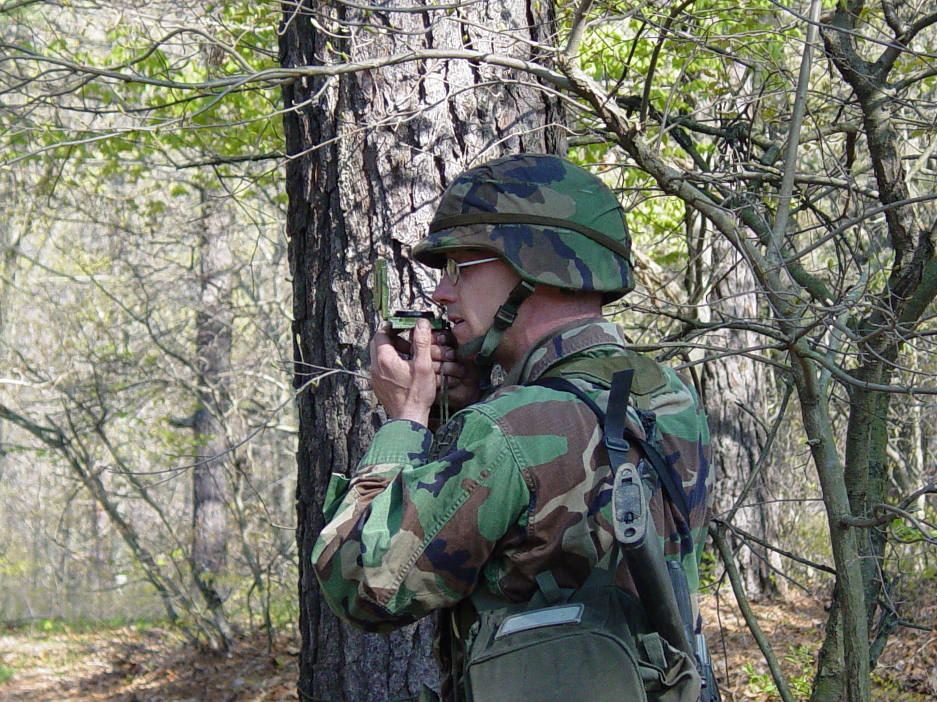
Compass to Cheek Method
Notes:
Compass-to-Cheek technique for holding a compass. When an azimuth has to be accurate you must use the compass-to-cheek method. To do this, open the cover to a 90-degree angle to the base. Position the eyepiece at a 45 degree angle to the base. Once you have the compass open, place your thumb through the thumb loop, form a steady base with your third and fourth fingers, and extend your index finger along the compass base. The compass will then rest firmly on the remaining fingers.
(2) Place the hand holding the compass into the palm of the other hand. Bring both hands up to your face and position the thumb that is through the thumb loop against the cheekbone. (3) Look through the lens of the eyepiece. If the dial is not in focus, move the eyepiece up or down until the dial is in focus. Align the sighting slot of the eyepiece with the sighting wire in the cover on the point for which the azimuth is being determined. Look through the lens of the eyepiece and read the azimuth under the index line.

Slide 96
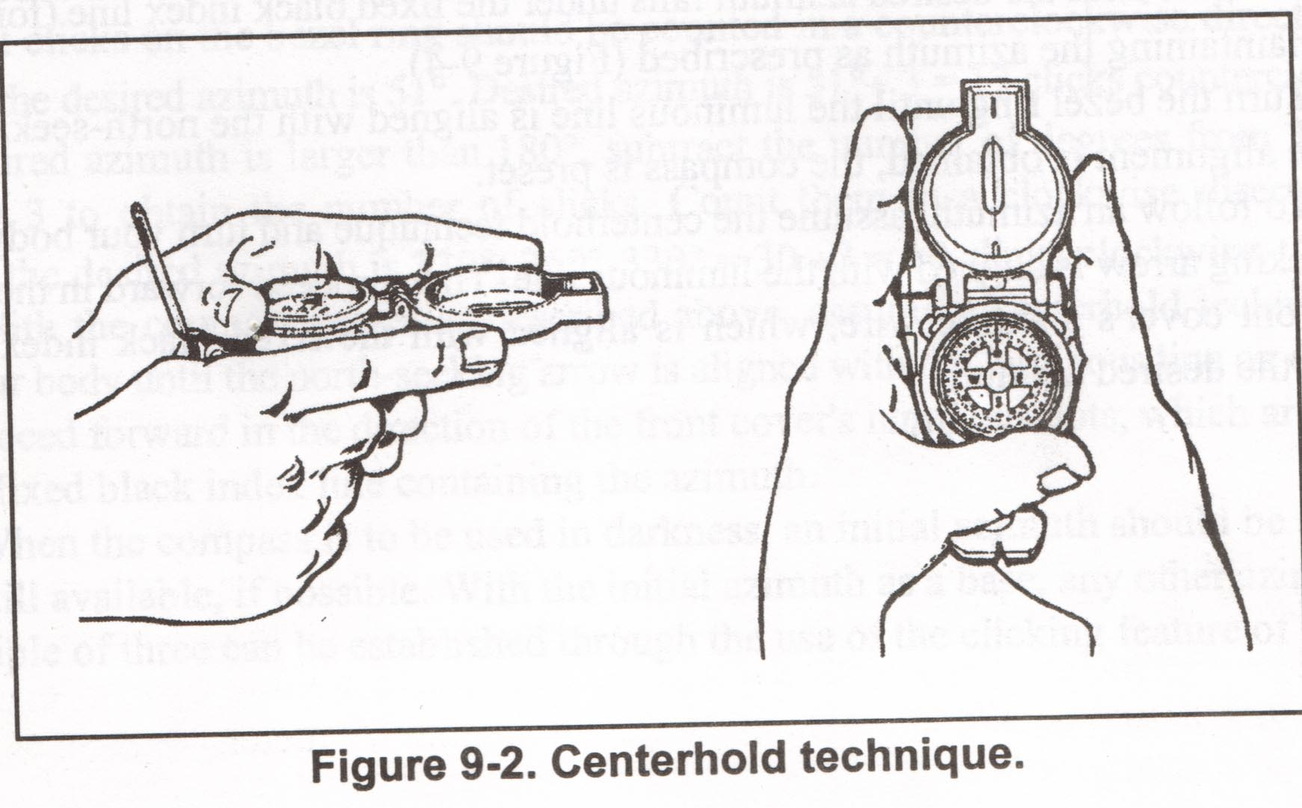
Center Hold Method
Notes:
Centerhold technique for holding a compass. The second method for shooting an azimuth is the centerhold method. This method is only used when a precise azimuth is not required. (1). To shoot an azimuth using this method, open the compass so that the cover forms a straightedge with the base. The eyepiece is moved back out of the way since it is not used. (2) Next, place your thumb through the loop, form a steady base with your third and fourth fingers, and extend your finger along the side of the compass. Place the thumb of the other hand between the eyepiece and lens, extend the index finger along the remaining side of the compass, wrap the remaining fingers around the fingers of the other hand, and pull your elbows firmly into your side. This will place the compass between your chin and your belt. (3) To measure an azimuth, turn your entire body toward the object and point the compass cover directly at the object. Look down and read the azimuth from beneath the fixed black index line.
(4) To lay out a direction to move on, hold the compass in the same manner. Rotate your whole body until the azimuth to be moved on is under the index line of the compass, then move in the direction of the cover.

Slide 97
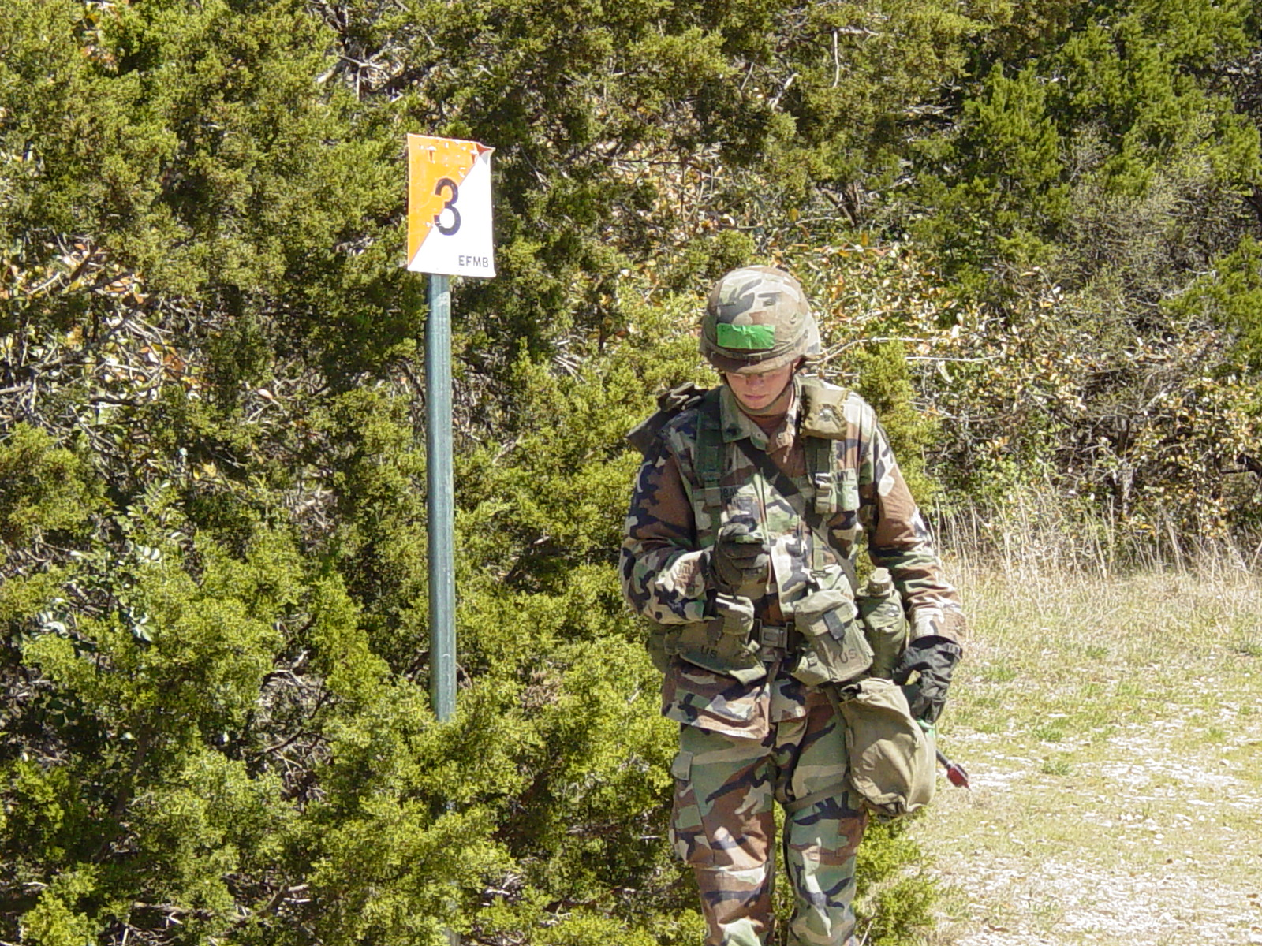
Center Hold Method
Use both hands
for
stability
Notes:
Centerhold technique for holding a compass. The second method for shooting an azimuth is the centerhold method. This method is only used when a precise azimuth is not required. (1). To shoot an azimuth using this method, open the compass so that the cover forms a straightedge with the base. The eyepiece is moved back out of the way since it is not used. (2) Next, place your thumb through the loop, form a steady base with your third and fourth fingers, and extend your finger along the side of the compass. Place the thumb of the other hand between the eyepiece and lens, extend the index finger along the remaining side of the compass, wrap the remaining fingers around the fingers of the other hand, and pull your elbows firmly into your side. This will place the compass between your chin and your belt. (3) To measure an azimuth, turn your entire body toward the object and point the compass cover directly at the object. Look down and read the azimuth from beneath the fixed black index line.
(4) To lay out a direction to move on, hold the compass in the same manner. Rotate your whole body until the azimuth to be moved on is under the index line of the compass, then move in the direction of the cover.

Slide 98
Shooting a Magnetic
Azimuth with a Compass
To determine a direction, point the compass in the direction you want to go or want to determine.
Look beneath the index line on the outer glass cover and estimate to the nearest 3 degrees or 10 mils the position of the index line over the red or black scale.
Be careful to hold the compass still and level so that the dial remains stationary while you are reading the scale.
If you understand these readings and can apply either of the holding and sighting techniques of shooting an azimuth, you will be proficient in performing this task.

Slide 99
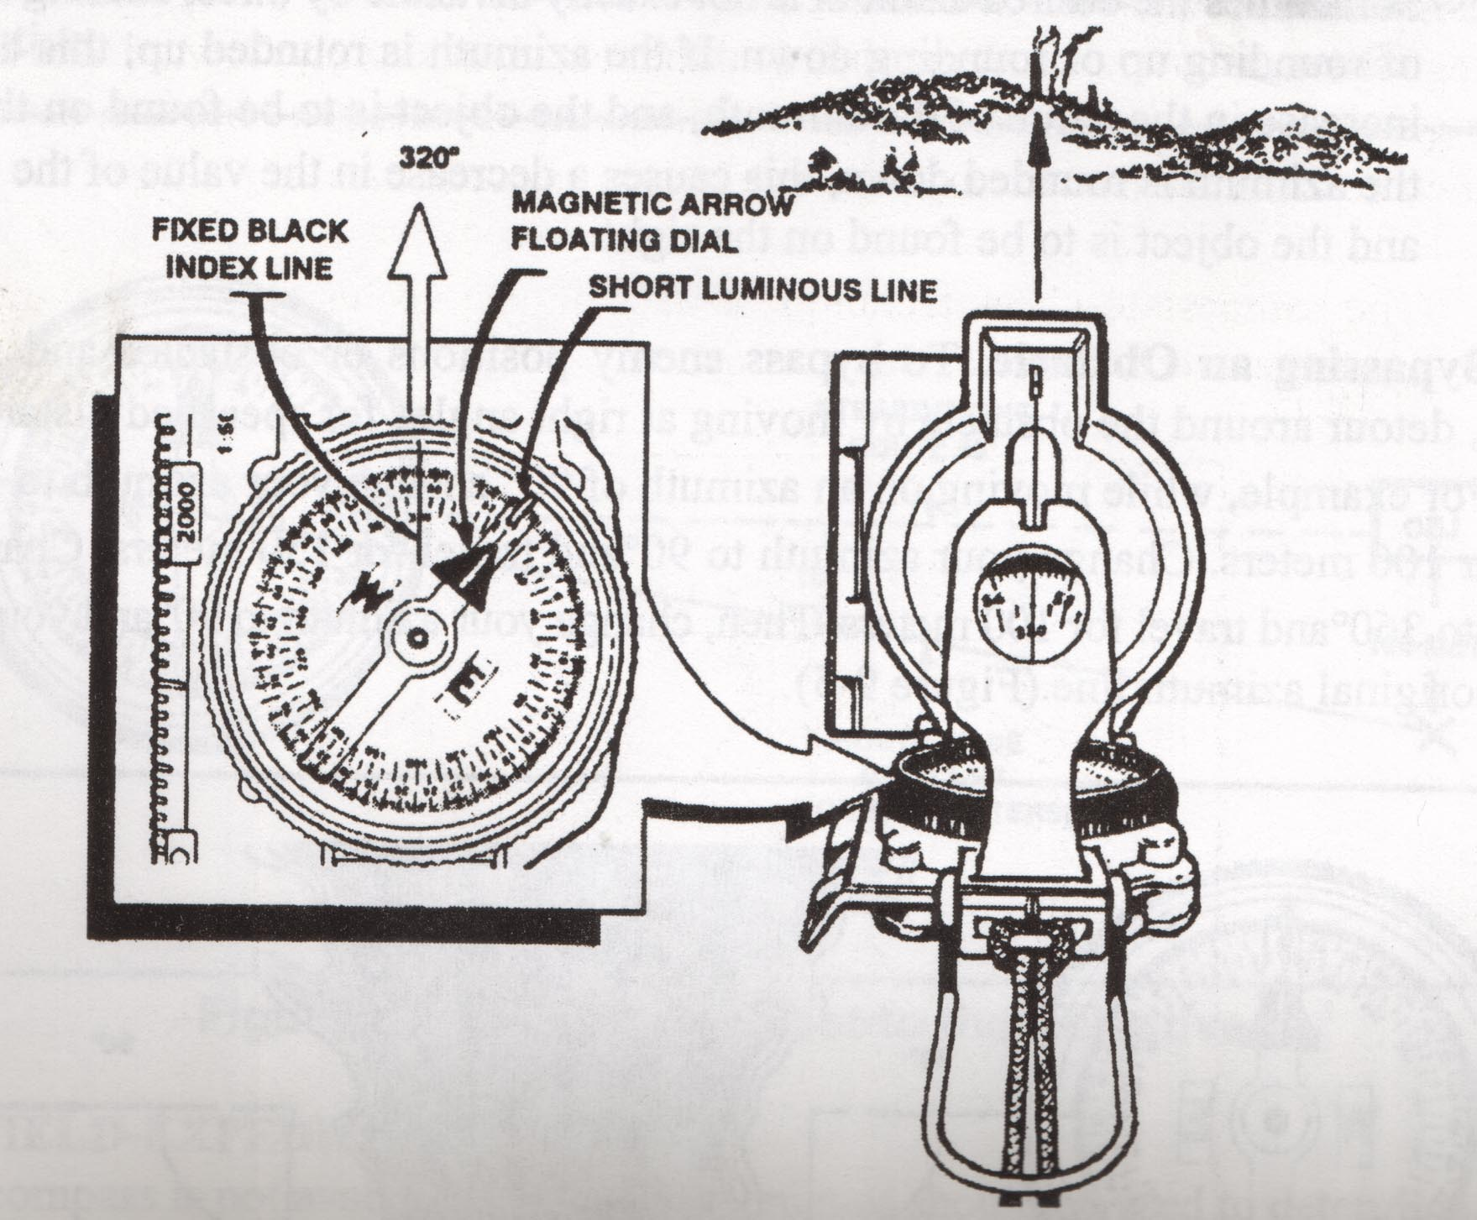
Shooting an Azimuth
Notes:
Look for the index line when sighting the compass. Where the index line crosses the scales of the floating disk, it shows an azimuth of 320 degrees in our example This is the degrees to follow to reach the hill as shown. If you understand these readings and can apply either of the holding and sighting techniques of shooting an azimuth, you will be proficient in this task.

Slide 100
Back Azimuth
A back azimuth is like doing an about face
How do you get a back azimuth:
0° to 180°
ADD 180°
181° to 360°
SUBTRACT 180°
FOR EXAMPLE
You are navigating to your point on an azimuth of 75°. You can’t find your
point and want to go back and try again. Find the back azimuth of 75°, which
is 255°. Shoot an azimuth of 255° and go back to your previous point.
You are navigating to your point on an azimuth of 215°. You can’t find your
point and want to go back and try again. Find the back azimuth of 215°, which
is 35°. Shoot an azimuth of 35° and go back to your previous point.

Slide 101
Pace Count
You learned how to figure the distance on the map, but to use that information on the course you need a pace count
A pace count is the method used to determine distance as you walk on the land nav course
The land nav site will have a 100 meter pace count for you
  Some sites will have one over rough terrain and another for on flat terrain

Slide 102
Determining Your
100 Meter Pace Count
At the start of the 100 meter pace count, step off with your left foot first and walk towards the end point of the pace count route
Every time your right foot hits the ground – COUNT
  Walk like you will be on the course
  Don’t take too long of steps
When you get to the end of the 100 meter pace count, the number you are on is your 100 meter pace count
  i.e. 64
Start
End

Slide 103

Using Your 100 Meter
Pace Count on the Course
Now that you know your 100 meter pace count (let’s say it is 64) you can determine how far you travel on the actual course
Let’s say you had to go 450 meters from SP to 1st Pt
“I found my first point. Time to write it down”
“32, that’s 50
More meters
450 total”
“64, that’s
100 meters”
“64, that’s
200 meters”
“64, that’s
300 meters”
“64, that’s
400 meters”
SP
SP
1st Pt
1
15
1
Walking on azimuth

Slide 104
Time to Put it All Together
To navigate the Land Navigation Course, both at day and night, you will have to put all of the information we discussed together.
The next slides will walk you through it.

Slide 105
PCIs for Land Nav
Listen closely to the cadre’s lane and safety briefing.
Verify your pace count.
Verify your compass and charge it if Night Land Nav.
Go through the shake down for unauthorized items.
Ensure you have all of your equipment.
  Compass
  Protractor
  Mechanical pencil **
  3” x 5” cards **
  Ziplock bag to store map and grade sheet so they don’t get wet**
  Clipboard **
  Piece of dental floss or the guts of 550 cord **
  Weapon, Protective Mask, Kevlar, etc.
** : These are suggested items to make it easier for you to plot your points.

Slide 106
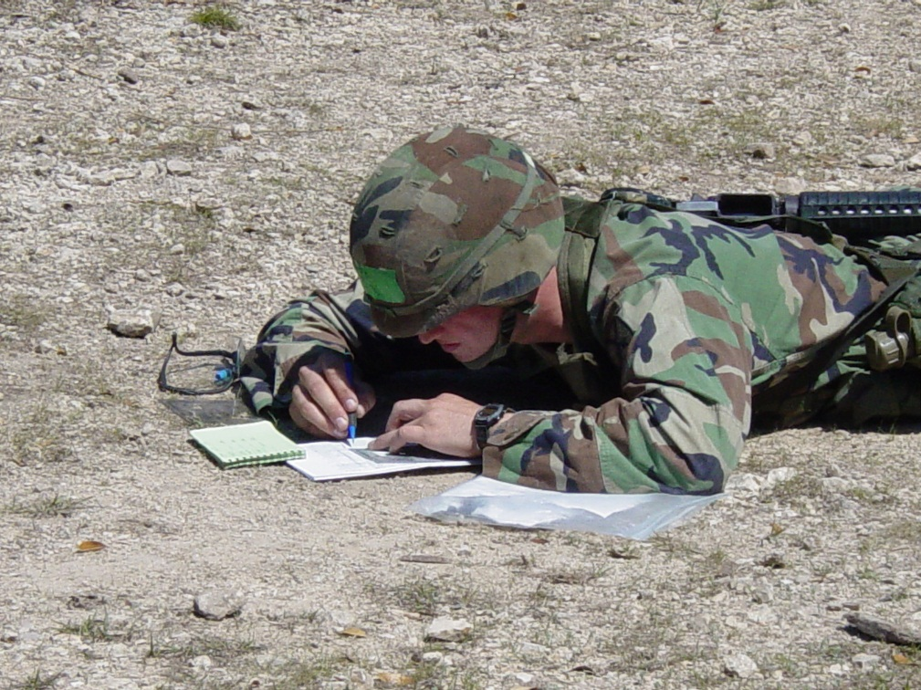

Issue Map and Grade Sheet
Cadre will issue you your map and grade sheet.
Cadre will take you or direct you to your start point.
Cadre will tell you when to start and write a start time. You are now on the clock.

Slide 107
Land Navigation Grade Sheet
Example
Grade Sheet
Example
Grade Sheet
1025

Slide 108

Plot Your Points
Utilize the information on your grade sheet, plot the 8 digit grids for your points using your protractor
  Label the points SP, 1, 2, 3, 4 (EP) while you plot them so you don’t get confused
EP
SP
3
2
1

Slide 109
Double Check Your Plotting
10. Double check your plotting.
  This is important, because if you incorrectly plot your points, you won’t find them!!!!!! You have time to reverify your plotting.
Ok, I plotted
them correctly!
EP
SP
3
2
1

Slide 110
Negotiate In Order
AMEDDC&S Pam 350-10 states that you must navigate from the start point, through the intermediate points, in order, to the end point.
EP
SP
3
2
1

Slide 111
Negotiating Your Course
There are two methods that are normally used to find your points (navigate to them). We will only discuss dead reckoning in depth.
Dead reckoning
  Finding the straight line distance and direction from one point to the next
Terrain Association
  Using terrain features and man made features to find your points.
    Using the roads
  Terrain association is NOT RECOMMENDED as the primary method for navigating to your points. Features may not be the same as what is on the map.

Slide 112

Terrain Association
    Candidates use this one so they don’t have to be in the woods. They just follow the roads, if possible.
    Major problem is that roads may not be “current” to what is depicted on the map
FOR EXAMPLE:
SP - 1: Walk south on road to 4th intersection turn right. Pt on corner at end of road
1 - 2: Follow road to the NW around curve for 400 meters. Pt on SE corner
2 - 3: Follow roads. Pt is on North side of unimproved road near a windmill.
3 – EP: Walk 800 meters at 93° to the east. Pt is on east side of a saddle between two hilltops.
WARNING
Terrain association is not recommended as the primary method for negotiating your course. Man made features change. Many maps are old and not up to date.
SP
2
1
3
EP

Slide 113
Plotting Your Course
Now that your points are plotted, it’s time to figure out the distance and direction (azimuth) for your course.
  Determine the distance and direction from SP to 1st, 1st to 2nd, 2nd to 3rd, and 3rd to EP.
  We will start with the SP to 1st Point

Slide 114
Plotting Your Course Cont.
Take one blank 3” x 5” card and write the information like on the example below.
    You could also do this on the back of your grade sheet.
    This will help you in plotting your course.
Distance
Azimuth
SP – 1:
1 – 2:
2 – 3:
3 – EP:

Slide 115
Plotting Your Course Cont.
    Determine the distance from SP to 1st Point
      Place other 3” x 5” card so that it bisects the two points
      Place a small tick on the 3” x 5” card at the middle of each point
Distance
Azimuth
SP – 1:
1 – 2:
2 – 3:
EP
SP
3 – EP:
3
2
1

Slide 116
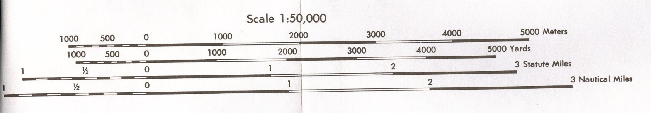
Plotting Your Course Cont.
  Move to the bar scale and determine the distance in meters between the ticks on the 3”x 5” card
  Then write it down on the 3” x 5” card next to SP - 1
Distance
Azimuth
SP – 1:
1,050 m
1 – 2:
2 – 3:
EP
SP
3 – EP:
3
2
1

Slide 117
Plotting Your Course Cont.
  Now, determine the grid azimuth from SP to 1st Point using protractor
    Draw a thin, light line through SP and 1st Point
    Place crosshairs on SP and align protractor so it’s parallel
    Look at degrees (inner reading on protractor) and locate degrees that run through 1st Point
    That is your grid azimuth, write in bottom of 3” x 5”
Distance
Azimuth
SP – 1:
1,050 m
1 – 2:
EP
SP
2 – 3:
3 – EP:
3
2
181°
1

Slide 118
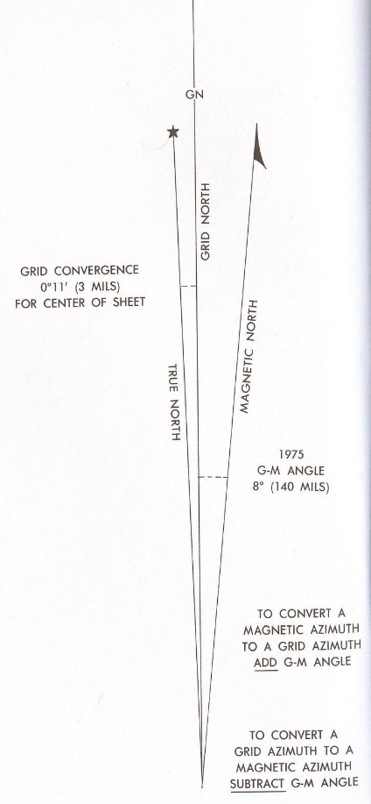
Plotting Your Course Cont.
    Now, convert it to magnetic azimuth using GM Angle
    Do the math on the bottom of 3” x 5” card or back of paper
    Once you have the magnetic azimuth, line through it
    Then write the magnetic azimuth on your 3” x 5” card or paper
Distance
Azimuth
SP – 1:
990 m
173°
1 – 2:
EP
SP
2 – 3:
3 – EP:
3
2
181° - 8 = 173°
1

Slide 119
Plotting Your Course Cont.
    Now do the same thing (find the distance and direction) for:
      1 to 2
      2 to 3
      3 to EP
Distance
Azimuth
SP – 1:
990 m
173°
1 – 2:
400 m
35°
EP
SP
2 – 3:
525 m
284°
3 – EP:
330 m
330°
3
2
338° - 8 = 330°
181° - 8 = 173°
43° - 8 = 35°
292° - 8 = 284°
1

Slide 120
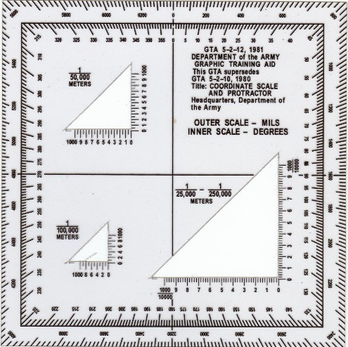
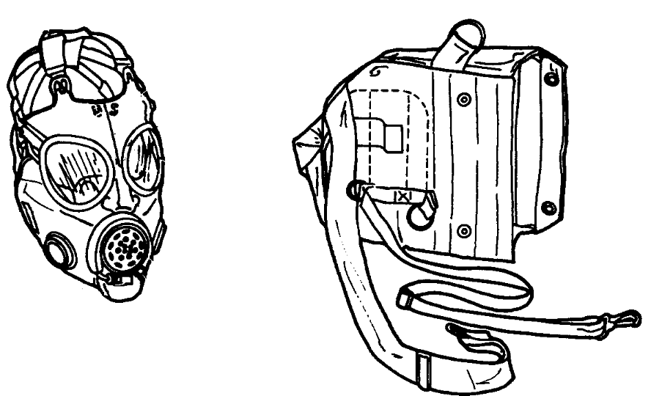
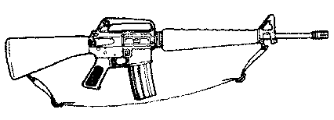
Securing Your Equipment
    Ensure that you have all of your equipment secured prior to navigating your course:
      Weapon and Protective Mask
      Map, grade sheet, protractor, mechanical pencil, 3” x 5” cards, etc are secured somewhere where you won’t lose them. PUT THEM IN A ZIPLOCK BAG.
        i.e. ammo pouch, cargo pocket, etc.

Slide 121


Navigating to Your Point
    Navigate from your SP to the 1st point using the distance and magnetic azimuth you determined.
      Use compass to cheek method during day
      Use centerhold method during night

Slide 122
Navigating to Your Point
    When you shoot your azimuth, pick a tree or something that is in the direct line of your azimuth and begin walking to it using your pace count
      Don’t take your eyes off of it while your walking
        If you fall, you’ll be all right!
      Pick a tree top out at night due to limited visibility
      Try not to forget your pace count
      Use your pace count beads or tie a knot in a piece of 550 cord after every 100 meters of your pace count

Slide 123
Searching for Your Point
    When you get to the end of your pace count for the distance you determined, look around for your point:
      If you see it, verify it using your map and terrain association
      If you don’t see it, utilize your map, determine where the point should be using terrain association and move to it
FOR EXAMPLE:
Pt 1: 150 meters north west of a hilltop
Pt 2: In a valley on the west side of a creek
EP: North side of a road
WARNING
Be careful when using man made features (i.e. roads). Man made features can change.
EP
SP
3
2
1

Slide 124
Searching for Your Point
    When you get to the end of your pace count for the distance you determined:
      Look around for a point
      If you don’t see it, mark your current location and move in a box or circle for the point in 10 meter increments to search for your point
CIRCLE METHOD
BOX METHOD
SP
SP

Slide 125
Can’t Find Your Point or
Forget Your Pace Count
    If you are walking on your pace count and lose track totally, do a back azimuth to where you had come from
    If you get to the end of your pace count and can’t find your point anywhere, do a back azimuth and return to the point you were and try again
CAN’T
FIND YOUR POINT
LET ME TRY
AGAIN
SHOOT
BACK AZIMUTH
THERE IT IS
1
12

Slide 126
Boxing an Obstacle
Sometimes you might come across an obstacle that you can’t go over or through. This is when you would need to box the obstacle.
I CAN’T GO OVER THIS.
I GUESS I’LL BOX IT.
150 meters
long
Azimuth
7
10 meters
high
BOX IT

Slide 127
How to Box an Obstacle
Take a look at the obstacle and see if it is easier to go to the left or right (i.e. right)
Pull out a 3” x 5” card, draw a sketch of how you’ll box the obstacle
Write your current pace count (i.e. 400 meters and 20 paces) [A]
I GUESS I’LL GO
TO THE RIGHT.
I’M AT 400 METERS
AND 20 PACES.
150 meters
long
225° Azimuth
7
A
10 meters
high
D
B
C

Slide 128
How to Box an Obstacle Cont.
Write the azimuth you are currently on (i.e. 225°) [A]
Now do a right/left face in the direction that you will box the obstacle. Add or subtract 90° to original azimuth (i.e. 315°)
Start walking on that azimuth keeping a new pace count (starting at 1), until you are clear of the obstacle and write it down on the card (i.e. 10 paces) [A] to [B]
150 meters
long
I’M AT 400 METERS
AND 20 PACES.
225° Azimuth
7
A
10 meters
high
315°
10 PACES
B

Slide 129
How to Box an Obstacle Cont.
Do a left face, shoot your original azimuth (i.e. 225°) and walk continuing your pace count that you had when you stopped at the obstacle [A] until clear past obstacle [B] to [C].
Write your pace count total down (i.e. 400 meters and 45 paces).
Now do a left face, subtract or add 90° from your original azimuth (i.e. 135°), shoot that azimuth, and walk the same number of paces that you did when you first boxed the obstacle (i.e. 10 paces) [C] to [D]
Do a right face. Now you can continue on your course. [D]
150 meters
long
THAT’S 400 METERS
AND 20 PACES.
THAT’S 400 METERS
AND 45 PACES.
225° Azimuth
7
D
225°
A
10 meters
high
315°
10 PACES
135°
10 PACES
SAME
B
C
225° 25 MORE PACES

Slide 130

Recording Your Point
    When you do find your point, write the number or letter of your point on your grade sheet
      Make sure you write it on the correct line
1025
3

Slide 131
Continue Navigating to Your Other Points
    Follow the same procedures until you reach your EP
    After recording it, a cadre member will be there to record your end time and direct you to the turn-in point
1025
1245
BCC
3
14
6
2

Slide 132

Receive Your Go or No Go
    Only the Land Nav NCOIC will tell you if you received a Go or No Go, not cadre at End Point
1025
1245
BCC
3
GO
4 for 4
14
6
2
X
X
X
X

Slide 133
Tips For Success
Bring a clipboard to use when you plot your points
Use a mechanical pencil to plot your points
  The smaller, but visible, you plot your point, the more accurate
  Bring at least two mechanical pencils
Bring a protractor that is cut correctly
Bring an extra compass in case yours breaks on the course

Slide 134
Tips For Success Cont.
Verify your pace count prior to going on course
Perform a compass check prior to going on course
Listen closely to the lane and safety briefing
Double check the plotting of your points
Don’t cheat
Write the position stake number/letter on the correct line on your grade sheet

Slide 135
Tips For Success Cont.
Don’t lose your map and/or grade sheet
  Automatic No Go!!!!!!!!
Carry your map and grade sheet somewhere where you won’t lose them
  i.e. Ammo pouch.
  Not in your helmet name band!!!!!!
Keep your weapon slung across your back so you don’t lose it
  Don’t take it off and set it against a tree. You’ll forget!
Even though it may seem easier, don’t use terrain association as your primary method of navigating to your points. You may be setting yourself up for failure.
Give yourself plenty of time to get back to a turn in table so you don’t go over time

Slide 136
Questions
Notes:
Questions.

Slide 137
Time to Practice

